Slide 1

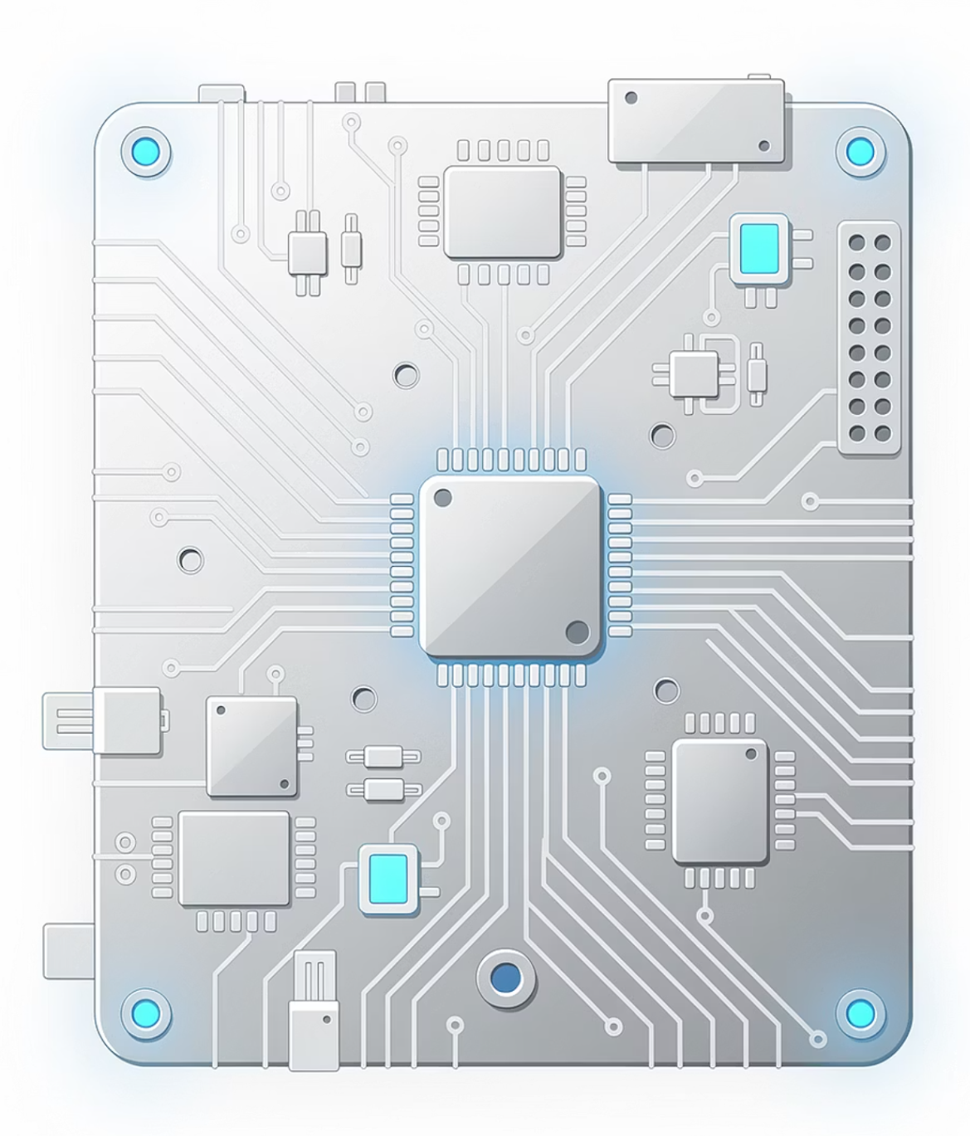
Foundations of Operating Systems & OSI Model
Understanding System Internals & Network Communication
1

Slide 2
Session Agenda
01
02
Operating System Basics
Kernel & OS Types
What is an OS, why it's required, and core responsibilities
Kernel vs User Space, popular OS examples, why Linux dominates servers
03
04
Networking Models
Real-World Scenarios
Introduction to layered networking and the OSI Model (7 Layers)
Diagrams, troubleshooting discussions, and practical examples
2

Slide 3
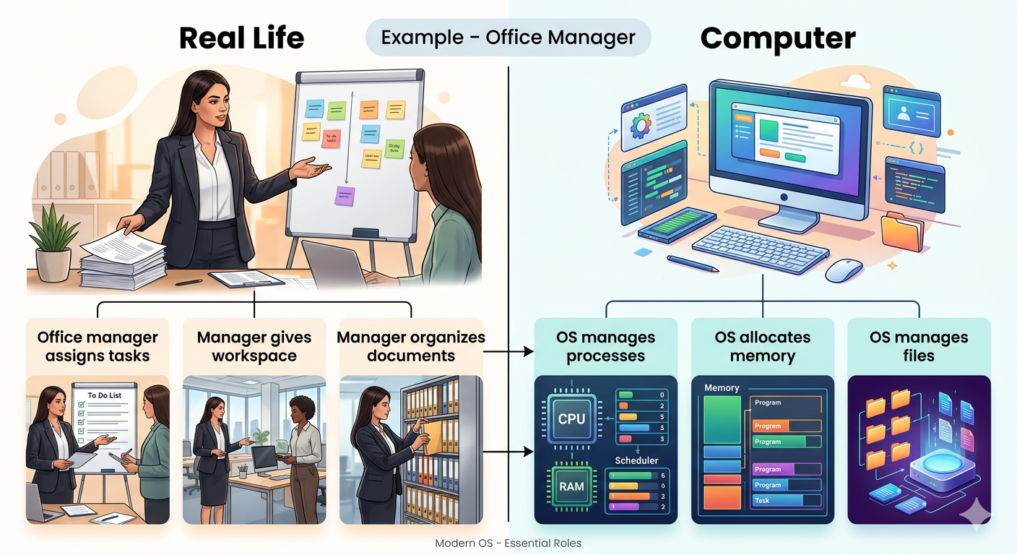

CONCEPT INTRODUCTION
What is an Operating System?
Symptoms : Office Manager
An Operating System (OS) is system software that:
Manages hardware & software resources
Acts as a bridge between the user and hardware
Makes computer hardware usable
Without an OS: Computer hardware is completely unusable.
3

Slide 4
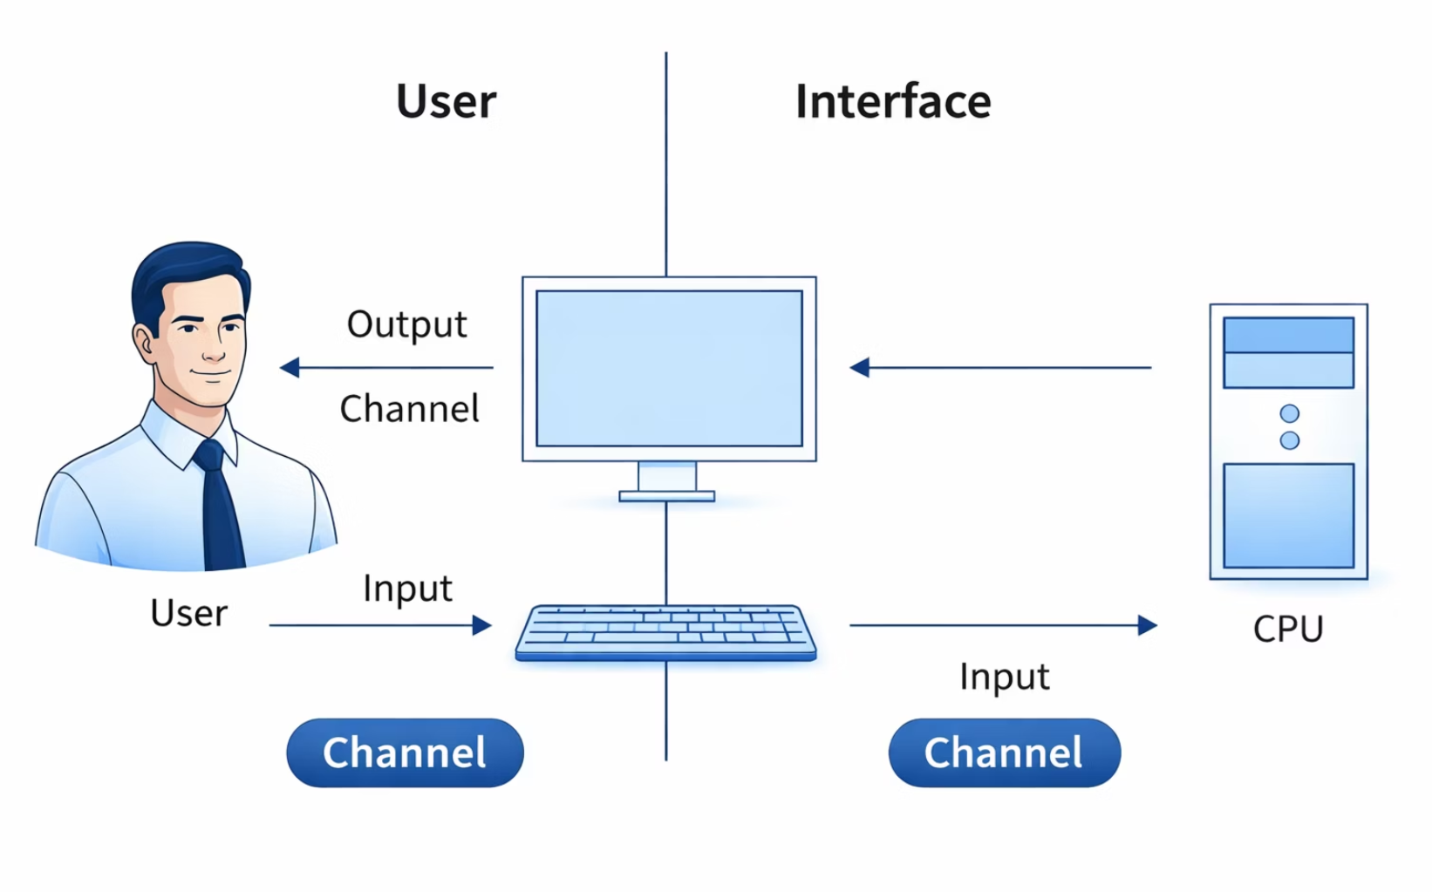
CONCEPT INTRODUCTION
Architecture - Operating System
4

Slide 5





Why is an OS Required?
CPU Management
Memory (RAM)
Storage
Schedules and allocates processing time
Allocates and tracks RAM usage
Manages files and disk access
Devices
Security
Controls keyboard, mouse, printer
Provides access control and protection
Example: When you click a file → the OS tells the CPU to open it.
5

Slide 6
CORE RESPONSIBILITIES
Main Responsibilities of an OS
1
Process Management
Allocates CPU time, switches between processes, handles multitasking
2
Memory Management
Allocates RAM, frees memory when apps close, prevents interference
3
File System Management
Organizes files & folders, controls permissions
4
Device Management
Uses drivers to communicate with hardware
5
Security & Access Control
Protects system resources and user data
6

Slide 7
Quiz Time
Q1. What is an Operating System?
✅ Answer: An Operating System is system software that manages hardware and allows applications to run on a computer.
Example: Common operating systems include Microsoft Windows, Linux, and macOS.
Q2. Why is an Operating System required?
✅ Answer: Because it manages CPU, memory, storage, and devices, allowing applications to run smoothly.
Example: When you open a browser, the OS gives it CPU time and RAM.
Q3. How does an OS handle multiple apps?
✅ Answer: The OS switches CPU time between processes quickly so multiple applications can run.
Example: You can run browser + music player + code editor at the same time.
7

Slide 8
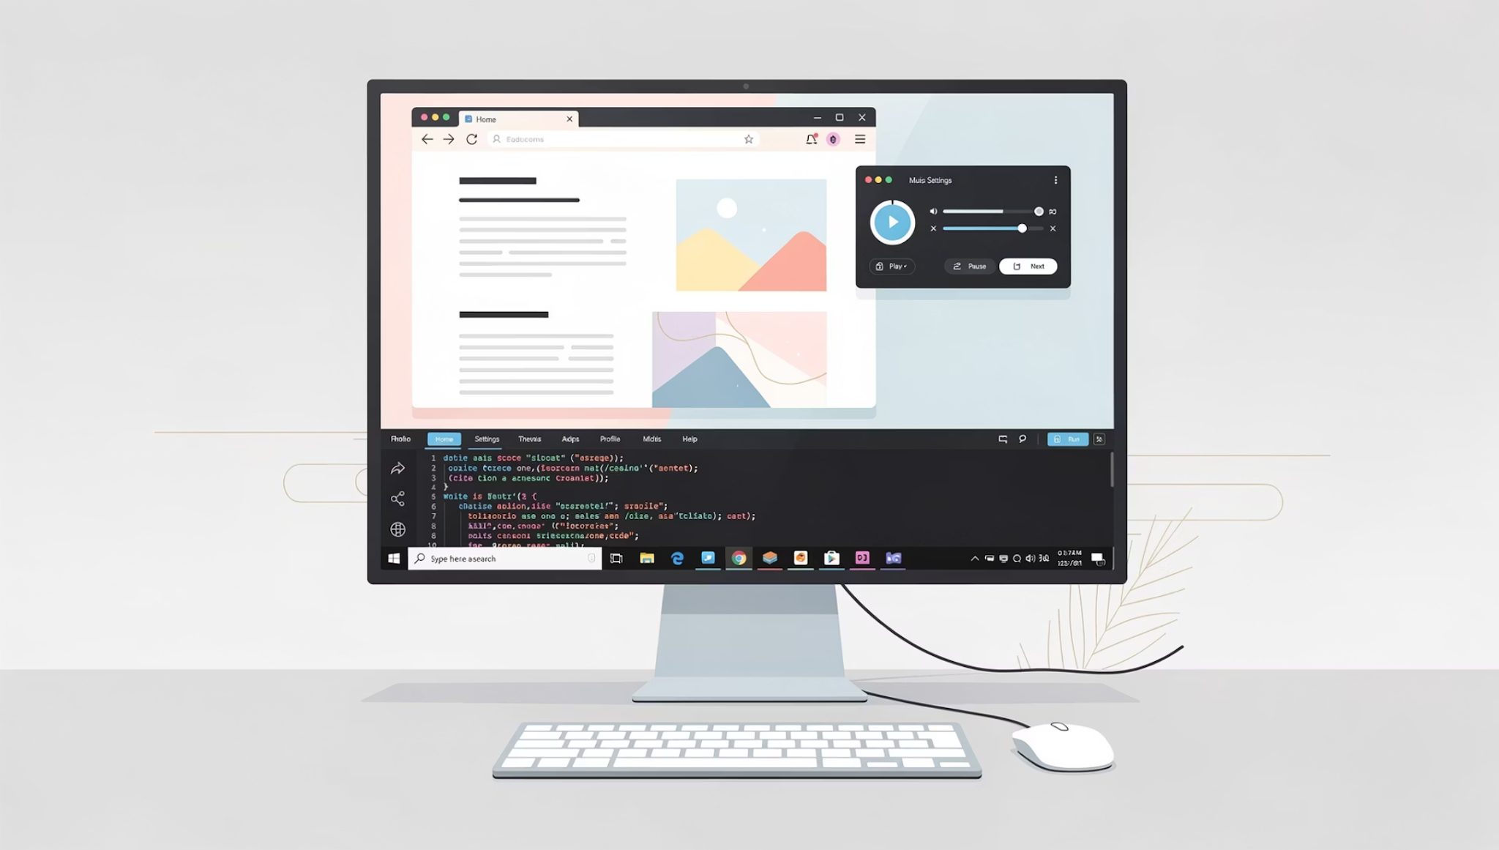
Process Management in Action
A Process is any running program — browser, music player, VS Code.
The OS manages all of them simultaneously by:
Allocating CPU time to each process
Rapidly switching between processes
Enabling seamless multitasking
8

Slide 9
Memory Management
Normal Operation
When RAM is Full
Allocates RAM to applications
Frees memory when app closes
Prevents apps from interfering with each other
System slows down
OS uses swap memory (disk)
Apps may crash
File & Device Management
Example: The printer works because the OS has a printer driver installed.
File system organizes files & controls permissions
Device drivers communicate with hardware
9

Slide 10
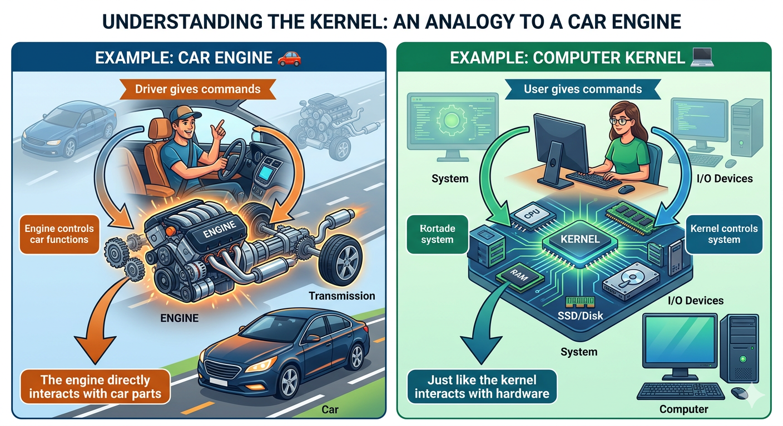
KERNEL VS USER SPACE
What is the Kernel?
Example: Car Engine
The Kernel is the core part of the OS:
Runs in privileged mode
Directly interacts with hardware
Kernel Responsibilities:
CPU scheduling
Memory allocation
Device control
10

Slide 11
Quiz Time
Q1. What is a Kernel?
✅ Answer: An Operating System is system software that manages hardware and allows applications to run on a computer.
Q2. Why do many servers use Linux?
✅ Answer: Because Linux is secure, stable, lightweight, and open-source.
Example: Most cloud servers use Linux.
Q3. What happens if the kernel crashes?
✅ Answer: The entire system may freeze or restart, because the kernel controls hardware and processes.
11

Slide 12
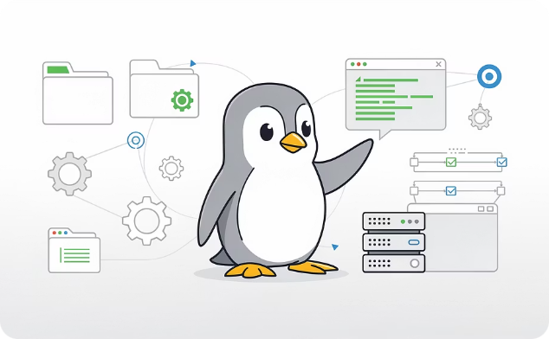
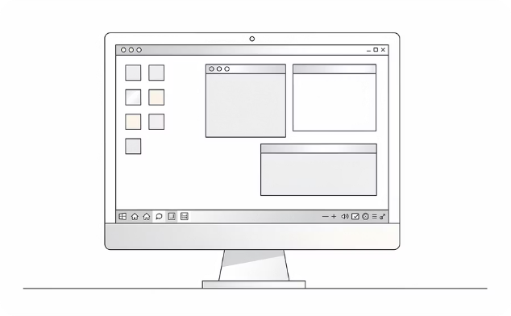
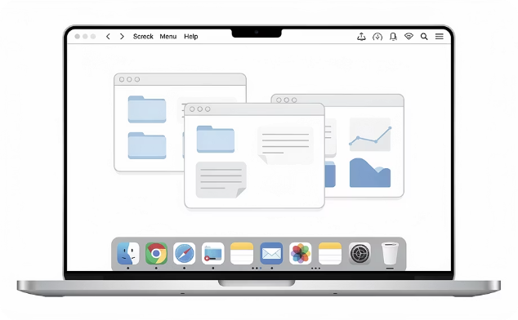
EXAMPLES OF OPERATING SYSTEMS
Popular Operating Systems
Linux
Microsoft Windows
macOS
Open-source, lightweight, highly customizable. Preferred for servers and cloud infrastructure.
Dominant desktop OS. User-friendly with broad software compatibility.
Apple's Unix-based OS. Known for stability, design, and creative workflows.
12

Slide 13
Why Most Servers Run Linux
Most cloud server run Linux
Open Source
Secure
Lightweight
Free to use and modify
Robust permission model
Minimal resource usage
Stable
Customizable
Runs for years without rebooting
Tailored for any workload
13

Slide 14
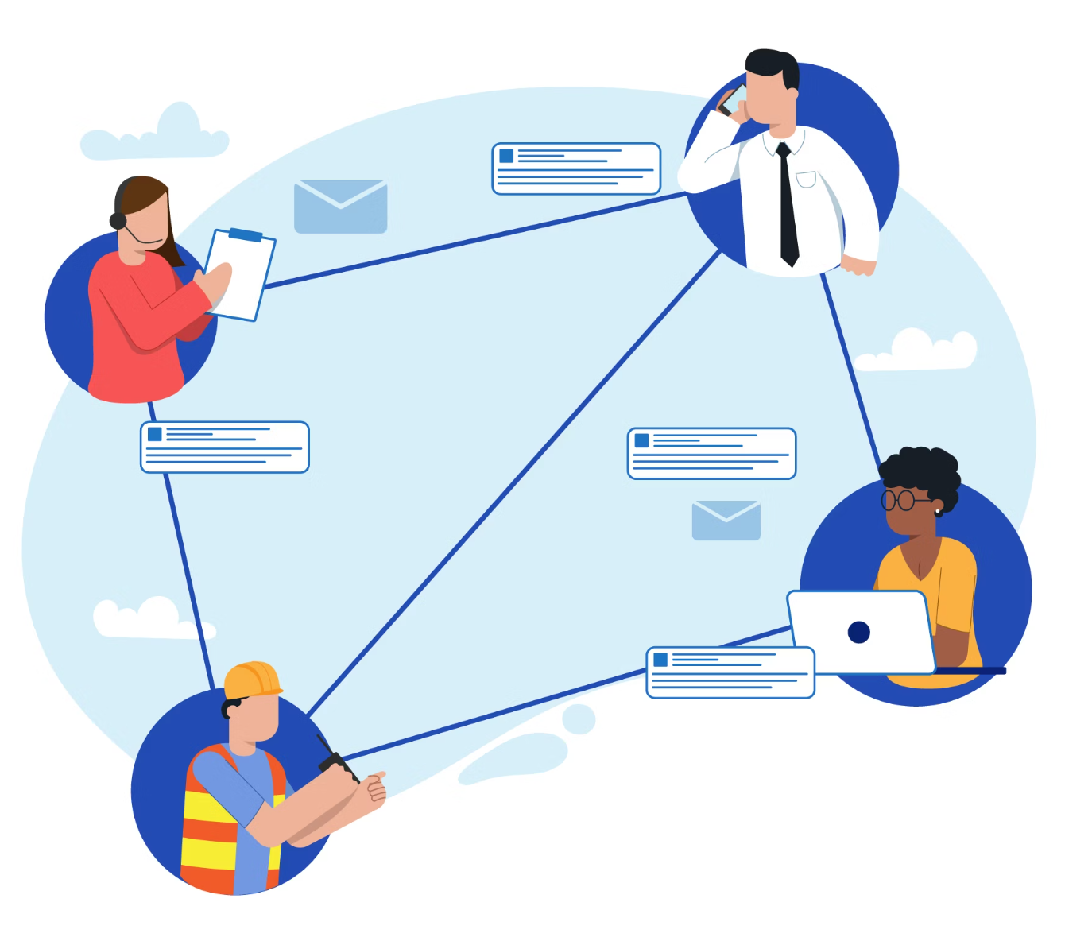
INTRODUCTION TO NETWORKING MODELS
Why Networking Models?
Networking is complex. To simplify communication, we divide it into layers.
Easier Troubleshooting
Isolate problems to a specific layer
Standardization
Universal rules across vendors
Clear Responsibilities
Each layer has a defined role
14

Slide 15
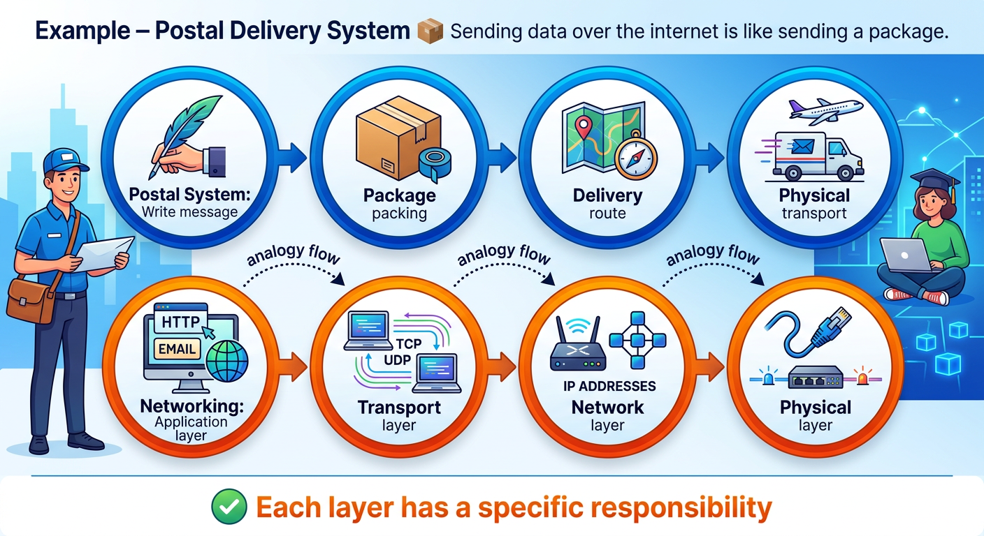
OSI MODEL
What is the OSI Model?
OSI = Open Systems Interconnection — a conceptual framework defining how data travels from one device to another across 7 layers.
1
Sender Device
Data originates here, passed down through layers
2
Network Medium
Physical transmission of bits across cables or wireless
3
Receiver Device
Data travels up through layers to the application
15

Slide 16
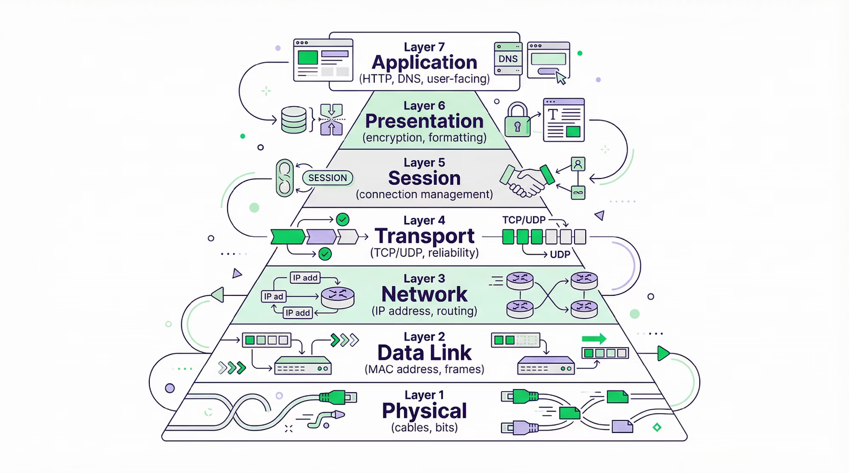

The 7 OSI Layers
16

Slide 17
Quiz Time
Q1. What is the OSI Model?
✅ Answer: The OSI Model is a framework that explains how data travels between devices using 7 layers.
Q2. Why do we use layered networking models?
✅ Answer: Layers make networks easier to design, understand, and troubleshoot.
Q3. How does the OSI model help in troubleshooting?
✅ Answer: It helps identify which layer has the problem.
Example:
Cable problem → Physical layer
Website not loading → Application layer
17

Slide 18



Purpose of Layered Architecture
Separation of Responsibilities
Real Examples
Each layer handles one specific function independently
Cable damaged → Physical Layer issue
Website not loading → Application Layer issue
Easier Debugging
Pinpoint exactly which layer has the issue
Interoperability
Different vendors can build compatible systems
18

Slide 19

REAL-WORLD EXAMPLES
How a Laptop Runs Multiple Apps
Running a browser, music player, and VS Code at the same time — the OS allocates CPU time, switches processes rapidly, and manages memory for each. This is called Multitasking.
19

Slide 20

What Happens When RAM is Full?
Symptoms
Normal State
RAM available, apps run smoothly
System becomes slow
Apps freeze or crash
High CPU usage
RAM Full State
Swap used, system slows and apps may freeze
Solutions
Close unused applications
Upgrade RAM capacity
When RAM is exhausted, the OS falls back to slower disk-based swap memory, causing visible performance degradation.
20

Slide 21
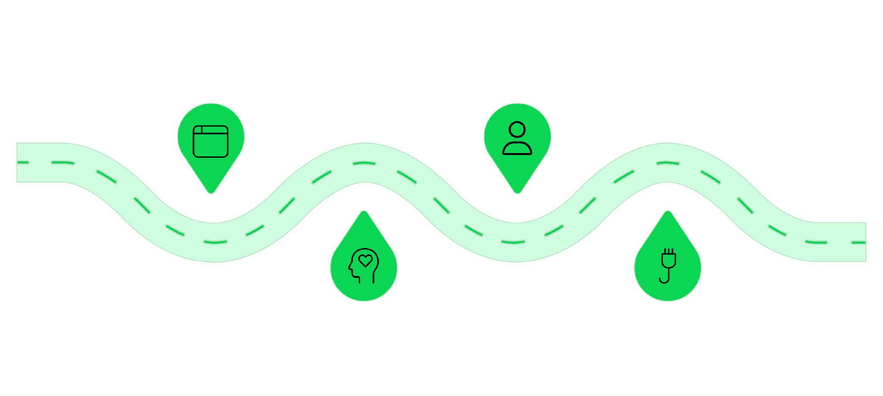




When You Open a Website
Open Browser
DNS Resolve
Start the application to load a site
Translate domain to IP address
Allocate Memory
Establish TCP
OS reserves memory for process
Three-way handshake opens connection
Every step involves the OS and multiple OSI layers working together — from memory allocation to network transport to application rendering.
21

Slide 22
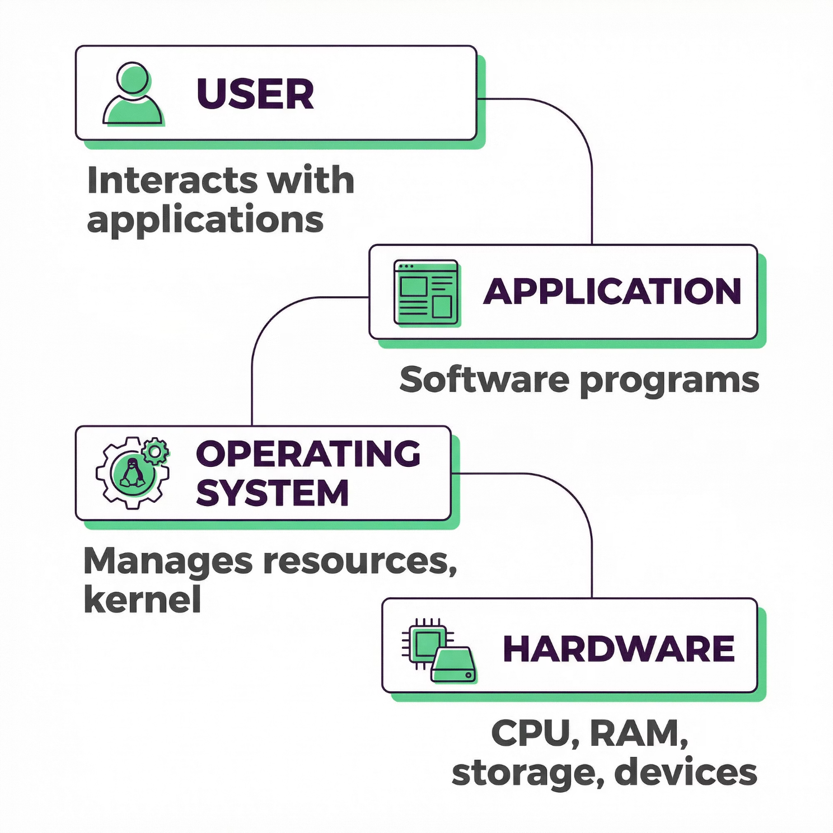

DEMO / DIAGRAM
Complete System Architecture
Every interaction flows through this stack. The OS sits between the user-facing application and the physical hardware — translating high-level requests into low-level hardware instructions.
The Kernel is the critical layer within the OS that directly communicates with hardware in privileged mode.
22

Slide 23
SCENARIO DISCUSSION
Scenario: System Hang & Slow Internet
🖥️ System Hang — Possible Causes
Q1: Is it a hardware issue or an OS issue?
High CPU usage
RAM full
Disk failure
OS bug
Answer: Could be hardware or OS — diagnosis required.
23

Slide 24
SCENARIO DISCUSSION
Scenario: System Hang & Slow Internet
🌐 Slow Internet — OSI Layer Analysis
Physical → Cable problem
Network → Routing issue
Transport → Packet loss
Application → Server slow
Q1: Is the problem affecting only one device or multiple devices?
Q2: Are websites loading slowly or not loading at all?
If one device → Check NIC, Wi-Fi adapter, or cable (Physical Layer).
If multiple devices → Likely router, ISP, or network-level issue.
Slow loading → Possible network congestion or packet loss (Transport/Network Layer).
Not loading → Check DNS or routing issues (Network Layer).
24

Slide 25
Key Takeaways
Operating System
Kernel
Linux for Servers
Bridge between user and hardware; manages CPU, RAM, storage, devices & security
Core of the OS running in privileged mode with direct hardware access
Open-source, secure, lightweight, stable, and highly customizable
OSI 7 Layers
Troubleshooting
Layered model enabling standardized, debuggable network communication
Real-world issues map to specific OS components or OSI layers
25

Slide 26


Thank You
26

